Slide 1
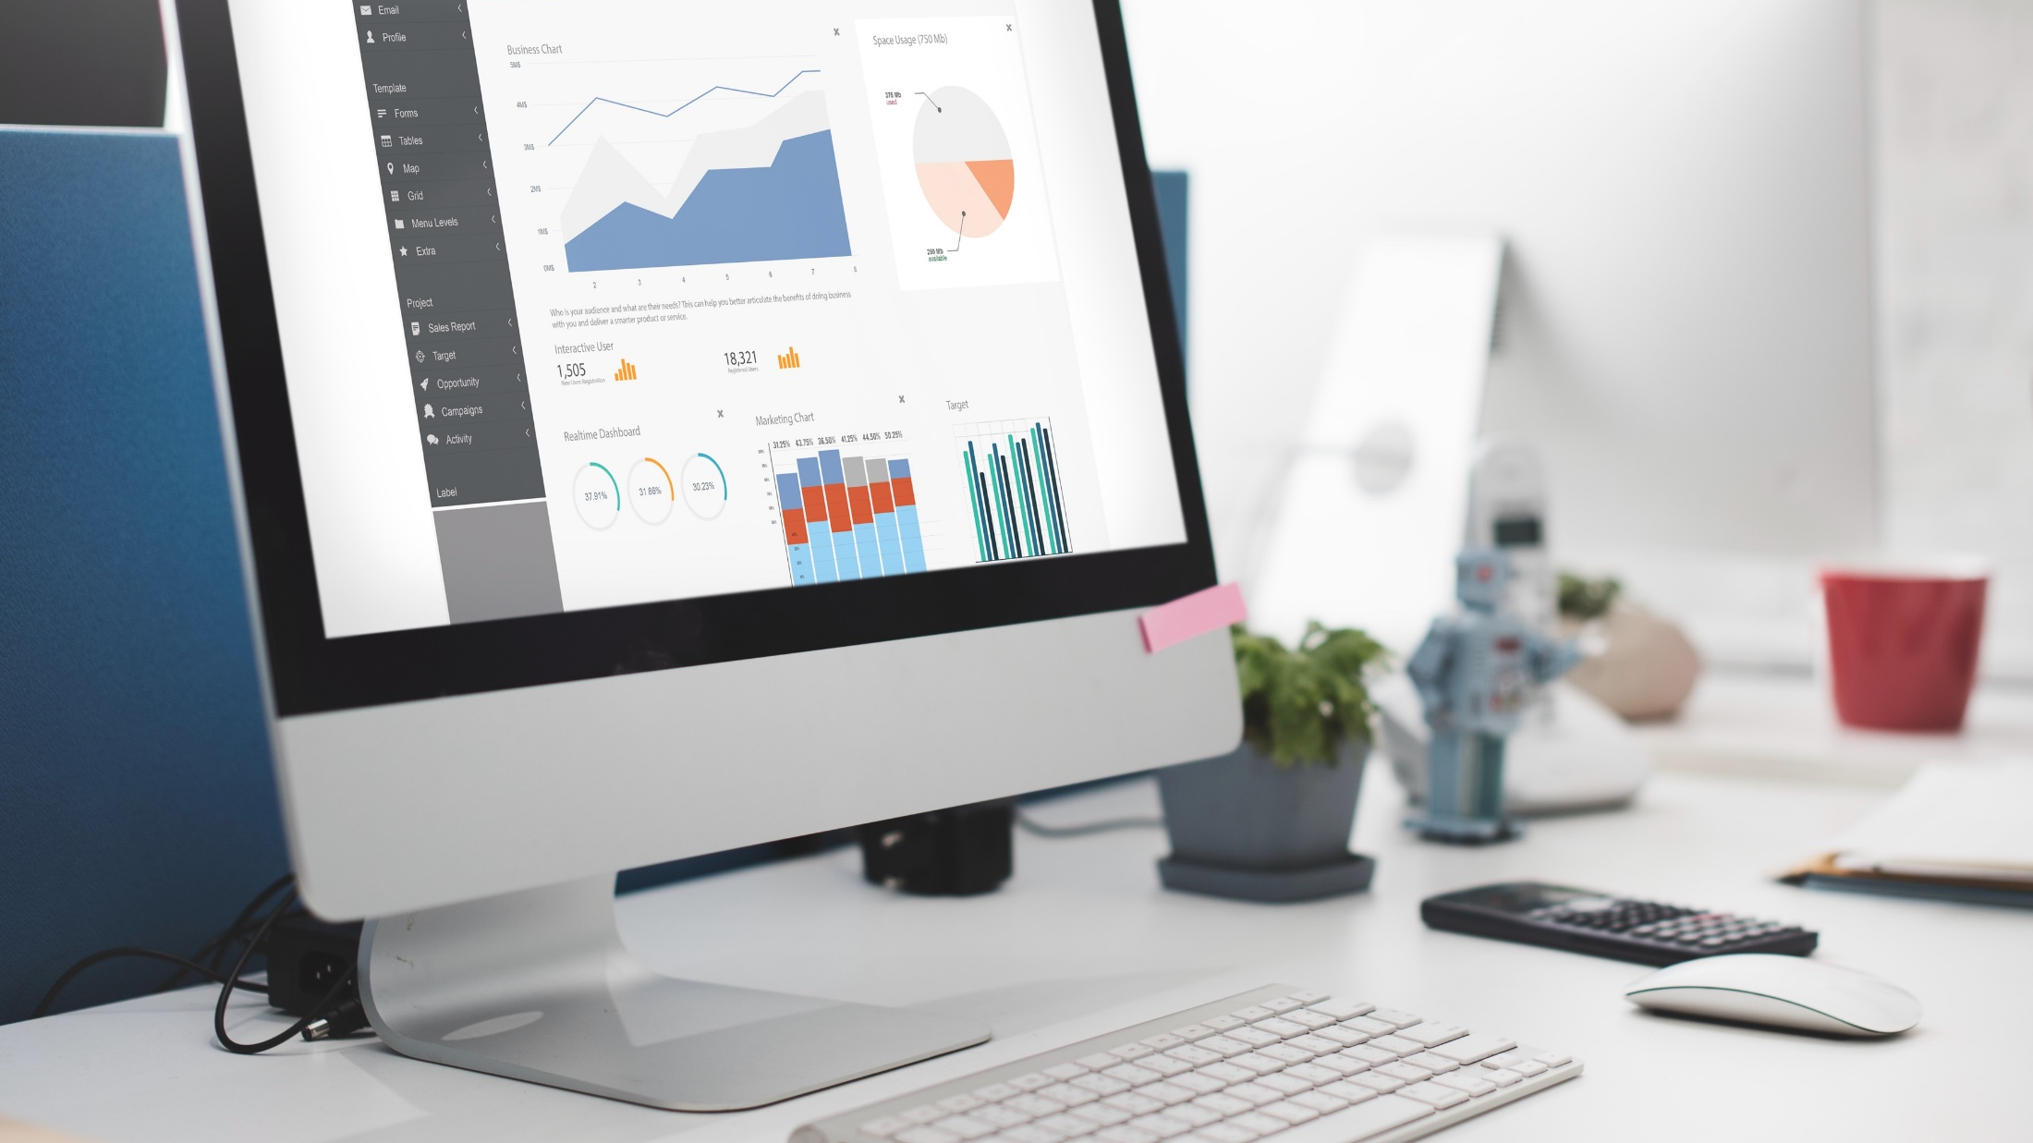
Data Analysis Presentation
by
ZOE B.

Slide 2

Introduction​
DATA ANALYSIS PRESENTATION Zoe B.
A Data /Business Intelligence Analyst with over 10 years of strong experience in performing analysis reporting, creating, and maintaining data migration design documentation, risk assessing, data mining, developing logical data models, and implementing data integration solutions across various industries.
Presentation Covers My Recent Job Experience
To showcase my skills and experience as a Data Analyst, and explain how I can contribute to the success and growth of your organization.

Slide 3

Contents​
DATA ANALYSIS PRESENTATION Zoe B.
Introduction​
Importance of Data Analysis​
Data Analysis Process​
Data Collection​
Data cleaning and Preparation​
Data Testing​
Data Analysis and Visualisations​
Examples of own work​
Qualifications/Skills​
Questions and Answers​

Slide 4







Why Data Analysis?
DATA ANALYSIS PRESENTATION Zoe B.
The ability to make a meaningful impact​
Over 10 years experience in Data Analysis​
Facilitated data-driven decision-making​
Worked on various data Projects.​
Passion for analytics and making a difference​
Covered a wide scope of data analysis areas.​
Ample experience with data visualisation tools.​

Slide 5


Data Analysis Process​
DATA ANALYSIS PRESENTATION Zoe B.
1
2
Data Analysis Process i was performing:
Data Collection:
I gathered data from reliable primary and secondary sources to ensure its relevance to business objectives.
Data Cleaning:
I removed duplicates, corrected errors, and handled missing values, standardizing data formats for consistency.
Data Validation:
I cross-checked data for accuracy and completeness, validating it against source systems and business rules.
Data Modeling:
I developed both logical and physical data models, defining relationships and dependencies within the data.
Data Analysis:
I employed statistical techniques and tools such as SQL, Python, and Power BI to identify trends, patterns, and correlations.
Data Analysis Tools & Techniques that i have used
Excel:
I used Excel to perform basic data analysis, create pivot tables, and develop visualizations for clear insights.
SQL:
I queried databases, performed data extraction, and conducted complex joins to retrieve and integrate data.
Python:
I utilized libraries like Pandas and NumPy for data manipulation and statistical analysis, and automated data processing tasks with scripts.
Power BI & Tableau:
I created interactive dashboards and visualizations in Power BI and Tableau to provide insightful reporting and support data-driven decision-making.

Slide 6
Data Collection​
DATA ANALYSIS PRESENTATION Zoe B.
Challenges in Data Collection
Data Inconsistencies:
Solution: I developed standardized data cleaning processes to ensure uniformity across datasets.
Missing Data:
Solution: I implemented imputation techniques and cross-verified missing data with secondary sources to fill gaps.
Data Collection Methods
Data Sources:
I extracted data from databases and other relevant sources to ensure comprehensive data collection.
Methodology:
I combined and cleaned data from various sources to ensure its accuracy and completeness.

Slide 7


Data Cleaning and Preparation​
DATA ANALYSIS PRESENTATION Zoe B.
Data Cleaning & Preparation
Data Cleaning:
I tackled duplicates, corrected errors, and addressed missing values to ensure high-quality data.
Standardized formats and worked to maintain consistency across all datasets.
Data Validation:
Cross-checked data with source systems and business rules to verify its accuracy.
Data Preparation:
Organized the data into structured formats that were ready for analysis.
Developing new metrics and variables, helped me to provide deeper insights and enhance the overall analysis.
​
Handling Missing Data
Imputation:
Used statistical methods to estimate and replace missing values.
Data Cross-Verification:
Cross-checked with secondary data sources to fill gaps.
Omission:
Excluded non-critical records with excessive missing data.
Predictive Modeling:
Employing algorithms to predict and fill in missing data based on existing patterns was very helpful.

Slide 8

Data Testing​
DATA ANALYSIS PRESENTATION Zoe B.
Ensures data accuracy​
Improves data quality​
Reduces risks​
Saves time and resources​
Improves confidence in the data​
Supports compliance
I

Slide 9



Data Analysis and Visualisation​
DATA ANALYSIS PRESENTATION Zoe B.
Insert Header Info
I created various types of charts, such as bar charts, line graphs, and pie charts, to represent data trends and comparisons clearly, as well as I designed interactive dashboards using Power BI and Tableau, enabling dynamic data exploration and real-time updates for comprehensive reporting.
Insert Header Info
Tools:
SQL
Tableau
Power BI
Excel.
I translated insights from the datasets into actionable recommendations, providing clear guidance to support strategic decision-making and improve business outcomes.
Subtitle Here
Subtitle Here

Slide 10

Data Interpretation and Reporting​
DATA ANALYSIS PRESENTATION Zoe B.
I examined data patterns and correlations to understand the underlying trends and behaviors
I prepared detailed reports and presentations, using clear visualizations to convey complex information. I also provided executive summaries to highlight key insights and recommendations
I tailored my communication to different stakeholders, including senior managers and department heads, ensuring that the findings were relevant and actionable for their specific needs.​​

Slide 11
Single Image & Content
DATA ANALYSIS PRESENTATION Zoe B.
I highlighted key trends in sales performance, identifying regions with declining sales and linking these trends to marketing strategies. This analysis led to targeted marketing efforts, which resulted in a 4% increase in sales.
For Example The company needed insights into sales trends and performance across different regions

Slide 12
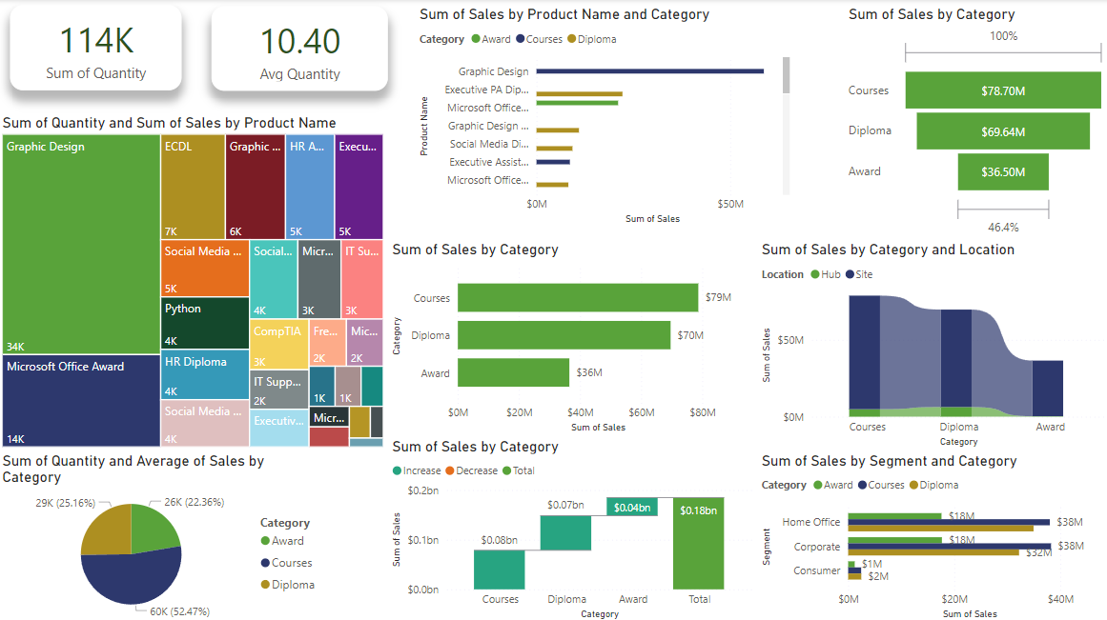
Example of Power BI Visual​

Slide 13
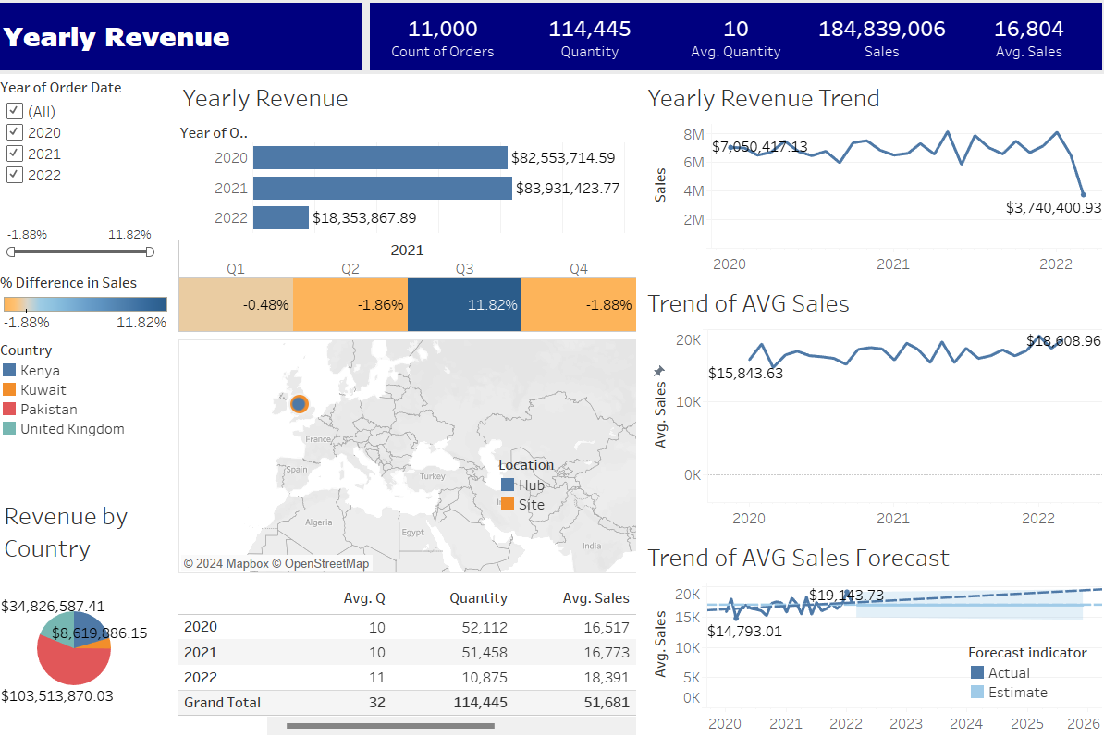
Example of Tableau BI Visual​

Slide 14
Your Qualifications and Skills​
DATA ANALYSIS PRESENTATION Zoe B.
1
Qualifications
Summarizing my qualifications and skills as a data analyst.​ How I Can Contribute:
Gathering data | Data modelling| Data mining| Data management | Data reporting | Data cleaning| Data visualisation| Dashboards| Data Mapping| Finding patterns| Predictive modelling | Significant testing| Competitive analysis | Forecasting analysis| Problem-solving| Critical thinking|
2
Certifications:
SAP TERP10;
AWS Certified Cloud Practitioner;
TOGAF 9 Foundation;
MDG100 SAP Master Data Governance.

Slide 15

Why should you hire me​
DATA ANALYSIS PRESENTATION Zoe B
Strong analytical skills​
Attention to detail​
Strong communication skills ​
Experience in data visualization​
Problem-solving skills​
Team player​
Continuous learning​
Overall - unique set of skills and experience​

Slide 16
THANK YOU
QUESTIONS?

